Slide 1
PHP and MySQL

Slide 2

Checking
Let’s get on with database… ☺
PHP Syntax … DONE!
Oh wait! We need a folder called phpweb in the htdocs directory.

Slide 3
Databases
Existing RDBMS libraries in PHP (located in php.ini file)
  MySQL
  MS SQL Server
  Oracle
  PostgreSQL
  SQLite
  Firebird

Slide 4
Databases
How about other RDBMS?
  Need to Google it first and IF available for PHP, download the library file
  Configure the library file inside php.ini
  e.g. IBM DB2

Slide 5
MySQL
It’s a FREE RDBMS (http://www.mysql.com)
Commonly used with PHP
How to manage your database?
MySQLCommand Line Client (100% using SQL statement)
[OR]
MySQLadministration software tool (click, click & click)
  e.g. phpMyAdmin(OSS, Freeware & Web-based)
  e.g. DBToolsManager (Freeware & Windows-based) –looks alike MS Access

Slide 6
MySQL Lab Session
Launch DBToolsManager
Create a new database named “phpweb”
Create fields below:
  studentid: integer, autoincremental= true
  studentname: varchar(255 char)
  studentnumber: integer
  studentusername: varchar
  studentpassword: varchar
Save the table as “student”

Slide 7
PHP and MySQL
2 ways to establish database connection
mysqli_connect()
  Establish a new connection each time a PHP page is called up and then close connection after completing the request using mysqli_close()
mysqli_pconnect()
  Persistent connection BUT it won’t close after completing the request
  Suitable for pages that do have a heavy usage
  Need to set up number of concurrent users

Slide 8

PHP and MySQL Lab Session
phpweb folder is your root folder. Place all your php files, images, etc in this folder.
Use notepad or dreamweaver to write php codes.
Now I create a folder in htdocs. Rename the folder to phpweb.

Slide 9
PHP and MySQL Lab Session A [1/2]
<?php
/* php& mysqldb connection file */
$user = "admin"; //mysqlusername
$pass = "admin"; //mysqlpassword
$host = "localhost"; //server name or ipaddress
$dbname= "phpweb"; //your db name
//continue next slide

Slide 10
PHP and MySQL Lab Session A [2/2]
// continue from previous slide
$dbconn= mysqli_connect($host, $user, $pass);
if(isset($dbconn)){
mysqli_select_db($dbname, $dbconn) or die("<center>Error: " . mysql_error($dbconn) . "</center>");
}
else{
echo "<center>Error: Could not connect to the database.</center>";
}
?>
Save as dbconn.php inside htdocs/phpweb/

Slide 11

PHP & MySQLLab Session B [1/1]
<html>
<body>
<form name="form" method="post" action="register0.php">
Name: <input type="text" name="name"><br>
Number: <input type="text" name="number"><br>
Username: <input type="text" name="username"><br>
Password: <input type="password" name="password"><br>
<input type="submit" name="submit" value="submit">
</form>
</body>
</html>
Save as register.php inside phpweb folder

Slide 12
PHP & MySQLLab Session C [1/4]
<?php
/* include db connection file */
include("dbconn.php");
if(isset($_POST['submit'])){
/* capture values from HTML form */
$name = $_POST['name'];
$number = $_POST['number'];
$username = $_POST['username'];
$password = $_POST['password'];
// continue to next slide…

Slide 13
PHP & MySQLLab Session C [2/4]
// continue from previous slide
$sql0 = "SELECT studentnumber FROM student WHERE studentnumber= $number";
$query0 = mysqli_query($dbconn, $sql0) or die ("Error: " . mysqli_error($dbconn));
$row0 = mysqli_num_rows($query0);
if($row0 != 0){
echo "Record is existed";
}
// continue to next slide…

Slide 14
PHP & MySQLLab Session C [3/4]
// continue from previous slide
else{
/* execute SQL INSERT command */
$sql2 = "INSERT INTO student (studentname, studentnumber, studentusername, studentpassword)
VALUES ('" . $name . "', '" . $number . "', '" . $username . "', '" . $password . "')";
mysqli_query($dbconn, $sql2) or die ("Error: " . mysqli_error($dbconn));
/* display a message */
echo "Data has been saved";
}
}// close if isset()

Slide 15
PHP & MySQLLab Session C [4/4]
// continue from previous slide
/* close db connection */
mysqli_close($dbconn);
?>
Save as register0.php inside phpweb folder

Slide 16
Testing your code…
Launch a web browser
Type in: http://localhost/phpweb/register.php
You should see an HTML form
Enter required values
Hit Submit button
If successful, you should see “Data has been saved” message

Slide 17

PHP & MySQLLab Session D [1/1]
<html>
<body>
<b>Login Page</b>
<form name="form" method="post" action="login0.php">
Username: <input name="username" type="text" id="username"><br>
Password: <input name="password" type="password" id="password"><br>
<input type="submit" name="Submit" value="Login">
</form>
</body>
</html>
Save as login.php inside phpweb folder

Slide 18
PHP & MySQLLab Session E [1/3]
<?php
session_start();
/* include db connection file */
include("dbconn.php");
if(isset($_POST['Submit'])){
/* capture values from HTML form */
$username = $_POST['username'];
$password = $_POST['password'];
if($username == "admin" && $password == "admin"){
$_SESSION['username'] = "Administrator";
header("Location: menuAdmin.php");
}
// continue next slide…

Slide 19
PHP & MySQLLab Session E [2/3]
// continue from previous slide…
else{
/* execute SQL command */
$sql= "SELECT * FROM student WHERE studentusername= '$username' AND studentpassword= '$password'";
$query = mysqli_query($dbconn, $sql) or die("Error: " . mysqli_error($dbconn));
$row = mysqli_num_rows($query);
if($row == 0){
echo "Invalid Username/Password. Click here to <a href='login.php'>login</a>.";
}
// continue next slide…

Slide 20

PHP & MySQLLab Session E [3/3]
// continue from previous slide…
else{
$r = mysqli_fetch_assoc($query);
$_SESSION['username'] = $r['studentname'];
header("Location: menu.php");
}
}
}
mysqli_close($dbconn);?>
Save as login0.php inside phpweb folder

Slide 21
PHP & MySQLLab Session F [1/1]
<?php
session_start();
if(isset($_SESSION['username']) && $_SESSION['username'] == "Administrator"){
?>
<html>
<body>
Hi, <?php echo $_SESSION['username']; ?> [<a href="logout.php">Logout</a>] <br>
<a href="search.php">Search</a>
</body>
</html>
<?php
} else {
header("Location: login.php");
}
?>
Save as menuAdmin.php inside phpweb folder

Slide 22

PHP & MySQLLab Session G [1/1]
<?php
session_start();
if(isset($_SESSION['username'])){
?>
<html>
<body>
Hi, <?php echo $_SESSION['username']; ?> [<a href="logout.php">Logout</a>]
</body>
</html>
<?php
} else {
header("Location: login.php");
}
?>
Save as menu.php inside phpweb folder

Slide 23
PHP & MySQLLab Session H [1/1]
<?php
session_start();
session_unset();
session_destroy();
header("Location: login.php");
?>
Save as logout.php inside phpweb folder

Slide 24
Testing your code…
Launch a web browser
Type in: http://localhost/phpweb/login.php
You should see an HTML form
Enter username and password
Hit Login button
If successful, you should see “Login Success” message

Slide 25
Break…
Next, let’s go to search process
Ok, done with registration and login processes

Slide 26
PHP & MySQL Lab Session I [1/5]
<?php
session_start();
if(isset($_SESSION['username']) && $_SESSION['username'] == "Administrator"){
?>
<html>
<body>
<b>Enter Student Number </b>
<form name="form" method="post" action="search0.php">
Student Number: <input type="text" name="snumber">
<input type="submit" name="Submit" value="Search">
</form>
</body>
</html>
<?php
}
else{
header("Location: login.php");
}
?>
Save as search.php inside phpweb folder

Slide 27
PHP & MySQL Lab Session I [2/5]
<?php
/* include db connection file*/
include("dbconn.php");
/* capture student number */
$number = $_POST['snumber'];
/* execute SQL statement */
$sql= "SELECT * FROM student
WHERE studentnumber= $number";
$query = mysqli_query($dbconn, $sql) or die ("Error: " . mysqli_error());
$row = mysqli_num_rows($query);
//continue next slide

Slide 28
PHP & MySQL Lab Session I [3/5]
//continue from previous slide
if($row == 0){
echo "No record found";
}
else{
$r = mysqli_fetch_assoc($query);
$studentid= $r['studentid'];
$studentnumber= $r['studentnumber'];
$studentname= $r['studentname'];
$studentpassword= $r['studentpassword'];
?>
//continue next slide

Slide 29
PHP & MySQL Lab Session I [4/5]
//continue from previous slide
<html>
<body>
<form name="form" method="post" action="process0.php">
ID:<input type="text" name="id" value="<?php echo $studentid; ?>"><br>
Student number:<input type="text" name="num" value="<?php echo $studentnumber; ?>"><br>
Name:<input type="text" name= "name" value="<?php echo $studentname; ?>"><br>
Password:<input type="password" name= "password" value="<?php echo $studentpassword; ?>"><br>
<input type="submit" name="Update" value="Update">
<input type="submit" name="Delete" value="Delete">
</form>
//continue next slide

Slide 30
PHP & MySQL Lab Session I [1/5]
//continue from previous slide
</body>
</html>
<?php
}
mysqli_close($dbconn);
?>
Save as search0.php inside phpweb folder

Slide 31
Break…
Next, let’s go to update and delete processes
Ok, done with registration and login processes
Simply create a menu page using Notepad / Dreamweaver

Slide 32
PHP & MySQL Lab Session J [1/2]
<?php
/* include db connection file */
include("dbconn.php");
/* update process */
if(isset($_POST['Update'])){
$id = $_POST['id'];
$name = $_POST['name'];
$password = $_POST['password'];
$sql= "UPDATE student SET studentname= '$name', studentpassword= '$password' WHERE studentid= $id";
$query = mysqli_query($dbconn, $sql) or die ("Error: " . mysql_error());
echo "Update success";
} //continue next slide

Slide 33
PHP & MySQL Lab Session J [2/2]
/* delete process */
if(isset($_POST['Delete'])){
$id = $_POST['id'];
$sql= "DELETE FROM student WHERE studentid= $id";
$query = mysqli_query($dbconn, $sql) or die ("Error: " . mysqli_error($dbconn));
echo "Delete success";
}
/* close connection */
mysqli_close($dbconn);
?>
Save as process0.php inside phpweb folder

Slide 34
Checking…
These are PHP files that supposedly you have created during lab session
a)dbconn.php
b)register.php => register0.php
c)login.php => login0.php => menuAdmin.php/menu.php => logout.php
d)search.php => search0.php => process0.php
We’re going to use these files for next session…

Slide 35
Checking…
1.Use mysqli_connect()or mysqli_pconnect()to establish database connection
2.Use mysqli_select_db()to select database
3.Use mysqli_query()to execute SQL statement
4.Use mysqli_num_rows()to check data existence (use with SELECT statement)
5.Use mysqli_fetch_assoc()for data retrieval

Slide 36

The End…

Slide 37
Adding jQuery to perform searching
jQuery can be incorporated into your program to query database and return the results on-the-fly.
To do this, we have to create 2 separate files, one with a simple html file and the other is a php file that will fetch the results from the database.

Slide 38
Creating HTML file
<html>
<head>
<meta http-equiv="Content-Type" content="text/html; charset=utf-8" />
<title>JQuery Live Search</title>
<script src="https://ajax.googleapis.com/ajax/libs/jquery/2.1.3/jquery.min.js"></script>
</head>
<body>
<h2 align="center">JQuery Live Search</h2><br />
<span>Search</span>
<input type="text" name="search_text" id="search_text" placeholder="Search by Student Details" />
<br />
<div id="result"></div>
<script>
$(document).ready(function(){
load_data();
function load_data(query){
$.ajax({
url:"fetch.php",
method:"POST",
data:{query:query},
success:function(data){
$('#result').html(data); }
});
}
$('#search_text').keyup(function(){
var search = $(this).val();
if(search != ''){
load_data(search);
}else{
load_data();
}
});
});
</script>
</body>
</html>
Save as jqsearch.php inside phpweb folder

Slide 39
Creating the php file
<?php
//fetch.php
include("dbconn.php");
$output = '';
if(isset($_POST["query"]))
{
$search = mysqli_real_escape_string($dbconn, $_POST["query"]);
$query = "
SELECT * FROM student
WHERE studentnumber LIKE '%".$search."%'
OR studentname LIKE '%".$search."%'
OR studentusername LIKE '%".$search."%'
";
}else{
$query = "SELECT * FROM student ORDER BY studentnumber";
$query = ""; //comment this line to list students upon page loading
}
if ($query!=""){
$result = mysqli_query($dbconn, $query);
if(mysqli_num_rows($result) > 0){
$output .= '<div class="table-responsive">
<table class="table table bordered"><tr>
<th>ID</th>
<th>Student Number</th>
<th>Name</th>
<th>Password</th>
</tr>';
while($row = mysqli_fetch_array($result)){
$output .= '
<tr>
<td>'.$row["studentid"].'</td>
<td>'.$row["studentnumber"].'</td>
<td>'.$row["studentname"].'</td>
<td>'.$row["studentpassword"].'</td>
</tr>
';
}
echo $output;
}else{
echo 'Data Not Found';
}
}else{
echo 'Data Not Found';
}
?>
Save as fetch.php inside phpweb folder

Slide 40
Extending your work to Android App
Now that your PHP program is running, you can extend it to be accessible to mobile platform. In this case, we are going to focus on Android application.
There is an easy way to develop your mobile application using free tools available on the internet.
You will need a google account to accomplish this task in order to log in to the system.
The resource is located at https://ai2.appinventor.mit.edu
The program will utilize the CRUD functions that we have covered previously.
Change the IP address in the block programming according to your settings

Slide 41
Preparing the Environment
You can either choose to test your application on your android hand phone or to run an emulator in your computer.
Your hand phone must be installed with MIT AI2 Companion and must be in the same network as your computer in order for the setting to work. (Hint: Hotspot or wireless network)
Your computer must be installed with MIT_Appinventor_Tools_2.3.0 in order for emulator to work. (https://appinventor.mit.edu/explore/ai2/windows.html)

Slide 42
Step 1: Preparing PHP JSON (Listing)
Results from the web server ought to be in the form of JavaScript Object Notation (JSON)
Create a php file to contain the following code
You may test the code in your browser to see the results
Save as list.php inside phpweb folder
<?php
include("dbconn.php");
$sql="select * from student";
$res=mysqli_query($dbconn,$sql) or die(mysqli_error($dbconn));
while($r=mysqli_fetch_array($res,MYSQLI_ASSOC)){
$json[]=$r;
}
echo json_encode($json,JSON_UNESCAPED_UNICODE);
mysqli_free_result($res);
mysqli_close($dbconn);
?>

Slide 43
Step 2: Making Listing Screen
Log on to ai2.appinventor.mit.edu and create a program called student
From the palette, drag listview into the viewer. (User Interface -> ListView)
Drag Horizontal Arrangement into the viewer, and a button into the Horizontal Arrangement. (Layout -> HorizontalArrangement)(User Interface -> Button)
Set HorizontalArrangement width to fill parent.
Drag User Interface -> Notifier into the viewer
Drag Connectivity -> Web into the viewer

Slide 44
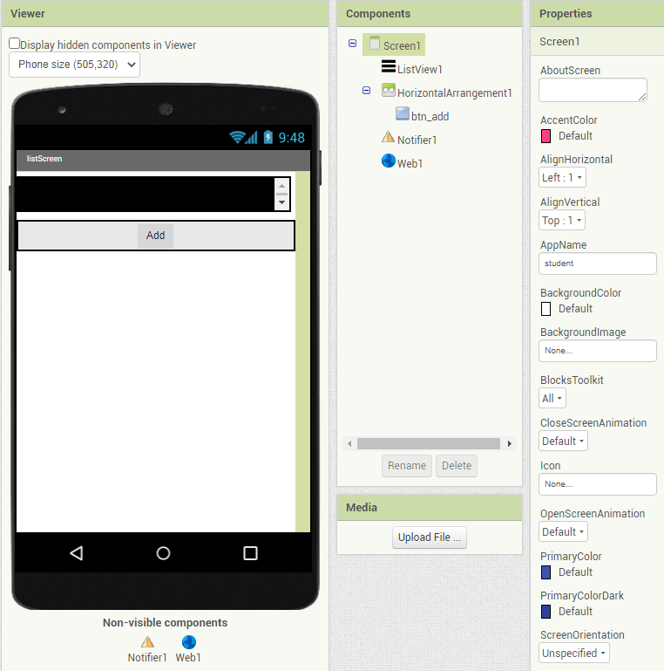
The Screen1 screen

Slide 45
Step 2: Continue…
Now click on the Blocks button at the top right hand corner of the page on your browser.
We are going to do some block coding when we launch the screen
After that, you may test the application either using the emulator or you phone

Slide 46
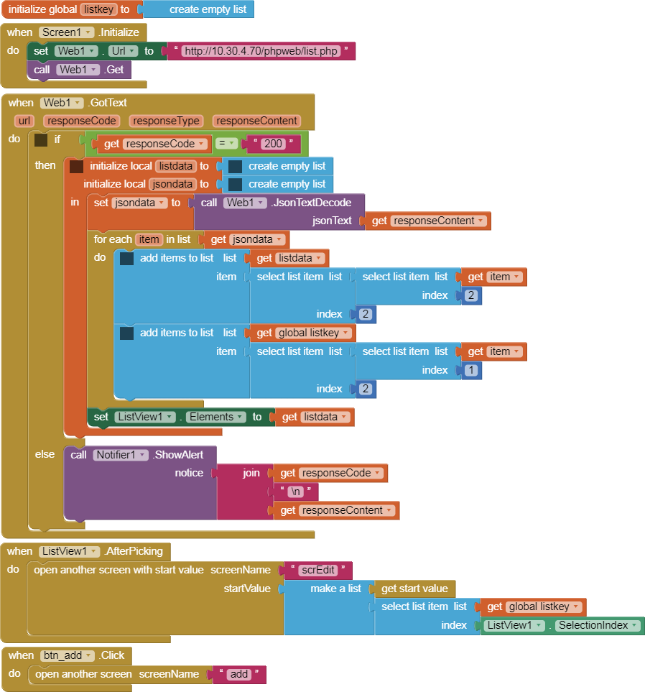
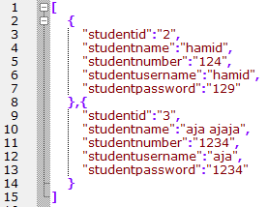
Block Code for the first page
This refers to which element
2 refers to [hamid, aja ajaja] (studentname)
1 refers to [2, 3] (studentid)
This refers to the 2nd column of JSON [2, hamid, 124 etc ]

Slide 47
Block Code Explanation
Initialize global listkey to create empty list
  This is to create a global list variable in which we store info
Screen1.Initialized is a block to execute when we run the program. In this case, we perform the GET method and we will receive results in JSON
Web1.GotText is another block to execute after we received the JSON results. For a list of response codes from web server, refer https://en.wikipedia.org/wiki/List_of_HTTP_status_codes
We then decode and populate the results into ListView
Otherwise, we will display the error in the notifier

Slide 48
Block Code Explanation
ListView1.AfterPicking is to allow user to pick the list for further listing. Eventually, this action will open another screen called scrEdit and we also pass the global variable that we have set earlier.
btn_add.Click is yet another block to execute should the button is clicked. In this case, it will open another screen called add.
You can switch between screens by selecting the pull down menu on the top of the viewer.

Slide 49
Step 3: The Add Screen
From the Screen1, clicking on the add button will initialize screen add.
You will need a PHP service to handle adding data to the database for this to work.
Test your work in the browser
<?php
include("dbconn.php");
$sname=@$_POST['sname']; //the @ is optional, to suppress error messages
$snumber=@$_POST['snumber'];
$suname=@$_POST['suname'];
$spass=@$_POST['spass'];
$sql="insert into student values(NULL,'$sname',$snumber,'$suname','$spass')";
$res=mysqli_query($dbconn,$sql) or die(mysqli_error($dbconn));
if ($res==1) echo "OK";
mysqli_close($dbconn);
?>
Save as add.php inside phpweb folder

Slide 50
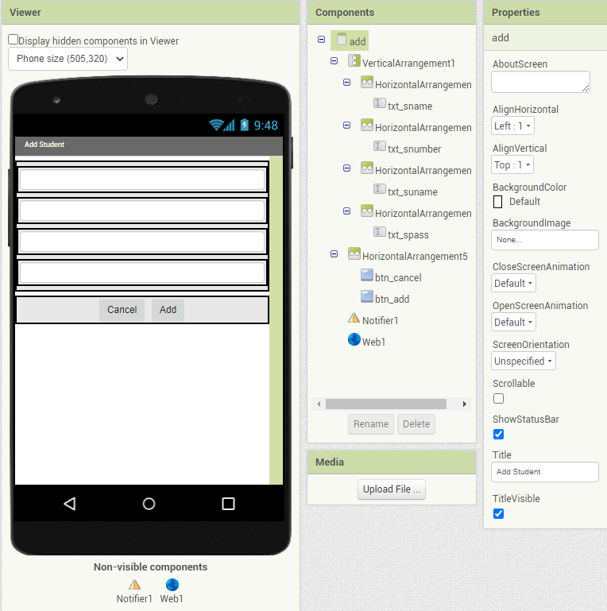
The add screen
Not necessary to put HorizontalArrangement in VerticalArrangement

Slide 51
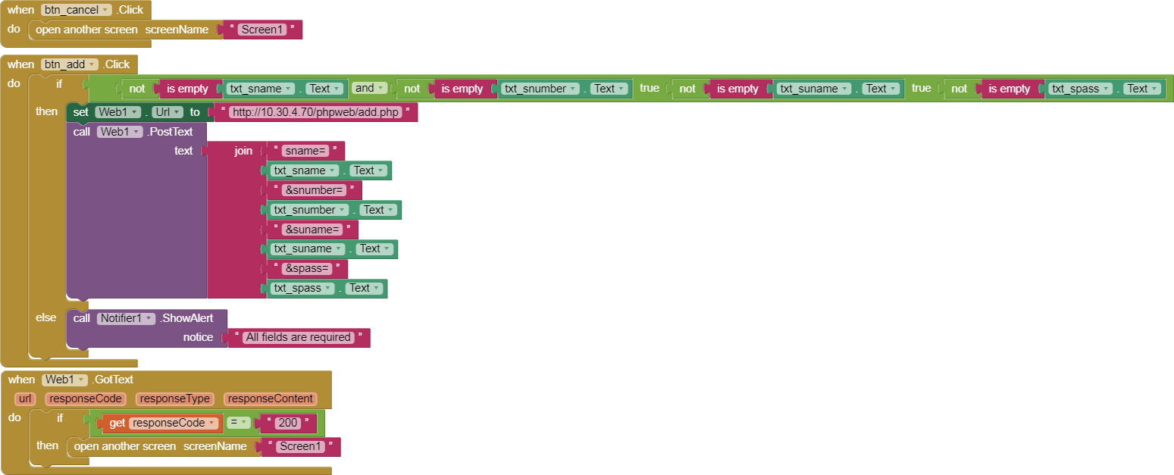
The block code

Slide 52
Step 4: Details PHP handler
The details handler is meant to retrieve a single record from the database when a user chooses a name from the listview in Scren1.
The screen scrEdit will be called and it will display the record for user to edit or delete.
Depending on the button that the user clicks, separate functions will be performed accordingly
Test your work

Slide 53
Details PHP handler
Test your work in the browser
<?php
include("dbconn.php");
$sid=@$_POST['sid']; //$sid=1; if you want to test
$sql="select * from student where studentid=$sid";
$res=mysqli_query($dbconn,$sql) or die(mysqli_error($dbconn));
$r=mysqli_fetch_array($res,MYSQLI_NUM);
$json[]=$r;
echo json_encode($json,JSON_UNESCAPED_UNICODE);
mysqli_free_result($res);
mysqli_close($dbconn);
?>
Save as details.php inside phpweb folder

Slide 54
Step 5: Edit and Delete
In this application, the edit and delete is performed with the same screen. To achieve this, we will need TWO PHP handlers to perform edit and delete separately.
Save as update.php inside phpweb folder
<?php
include("dbconn.php");
$sid=@$_POST['sid'];
$sname=@$_POST['sname'];
$snumber=@$_POST['snumber'];
$suname=@$_POST['suname'];
$spass=@$_POST['spass'];
$sql="update student set studentname='$sname', studentnumber='$snumber', studentusername='$suname', studentpassword='$spass' where studentid=$sid";
$res=mysqli_query($dbconn,$sql) or die(mysqli_error($dbconn));
if ($res===true) echo "OK_EDIT";
mysqli_close($dbconn);
?>

Slide 55
Test your work in the browser
<?php
include("dbconn.php");
$sid=@$_POST['sid']; //$sid=1;
$sql="delete from student where studentid=$sid";
$res=mysqli_query($dbconn,$sql) or die(mysqli_error($dbconn));
if ($res==1) echo "OK_DEL";
mysqli_close($dbconn);
?>
Save as delete.php inside phpweb folder

Slide 56
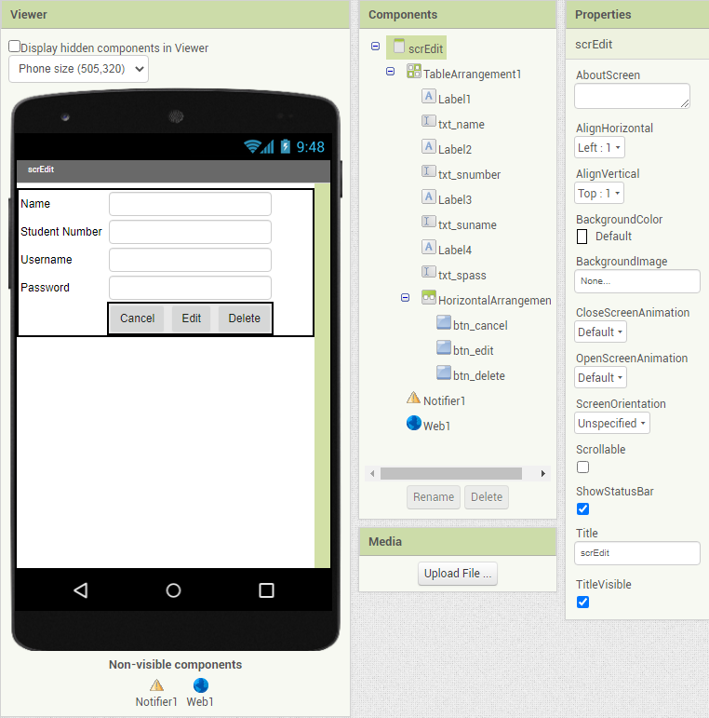
The scrEdit Screen

Slide 57
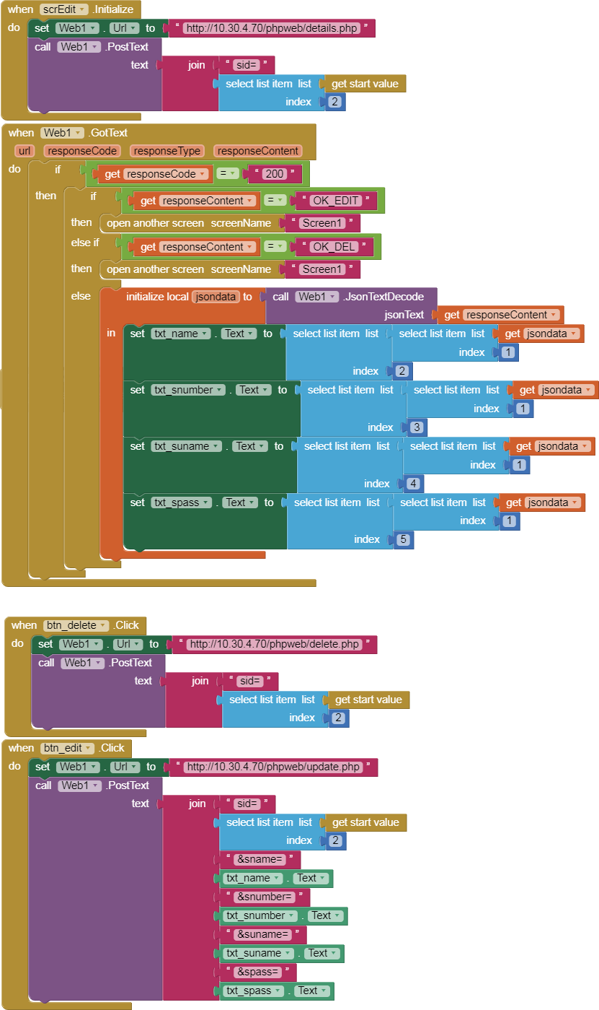
The Block Codes

Slide 58
The End…

